Slide 1
AE 3531: Intro to your final project
Brian Kaplan & Morgan Cook

Slide 2
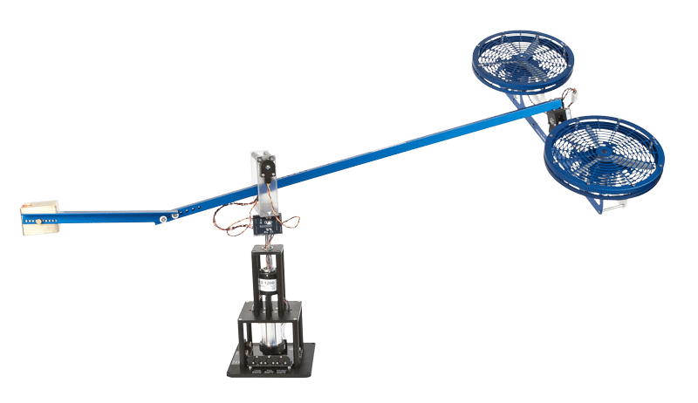
Rationale
Goal: provide a complete understanding of a very basic, yet functional controller
Disadvantages of Quanser (AE 4610)
Expensive (~$10k - $20k)
Bulky
Complex (Both Theory and Software)
Why you are doing this project:
Introduction to various types of control
Transparency of the controller
Experience with Arduino and basic electromechanical systems

Slide 3
What if...
You could have your own personal system?
It was simple, compact, and affordable?
It could replace your final exam?

Slide 4
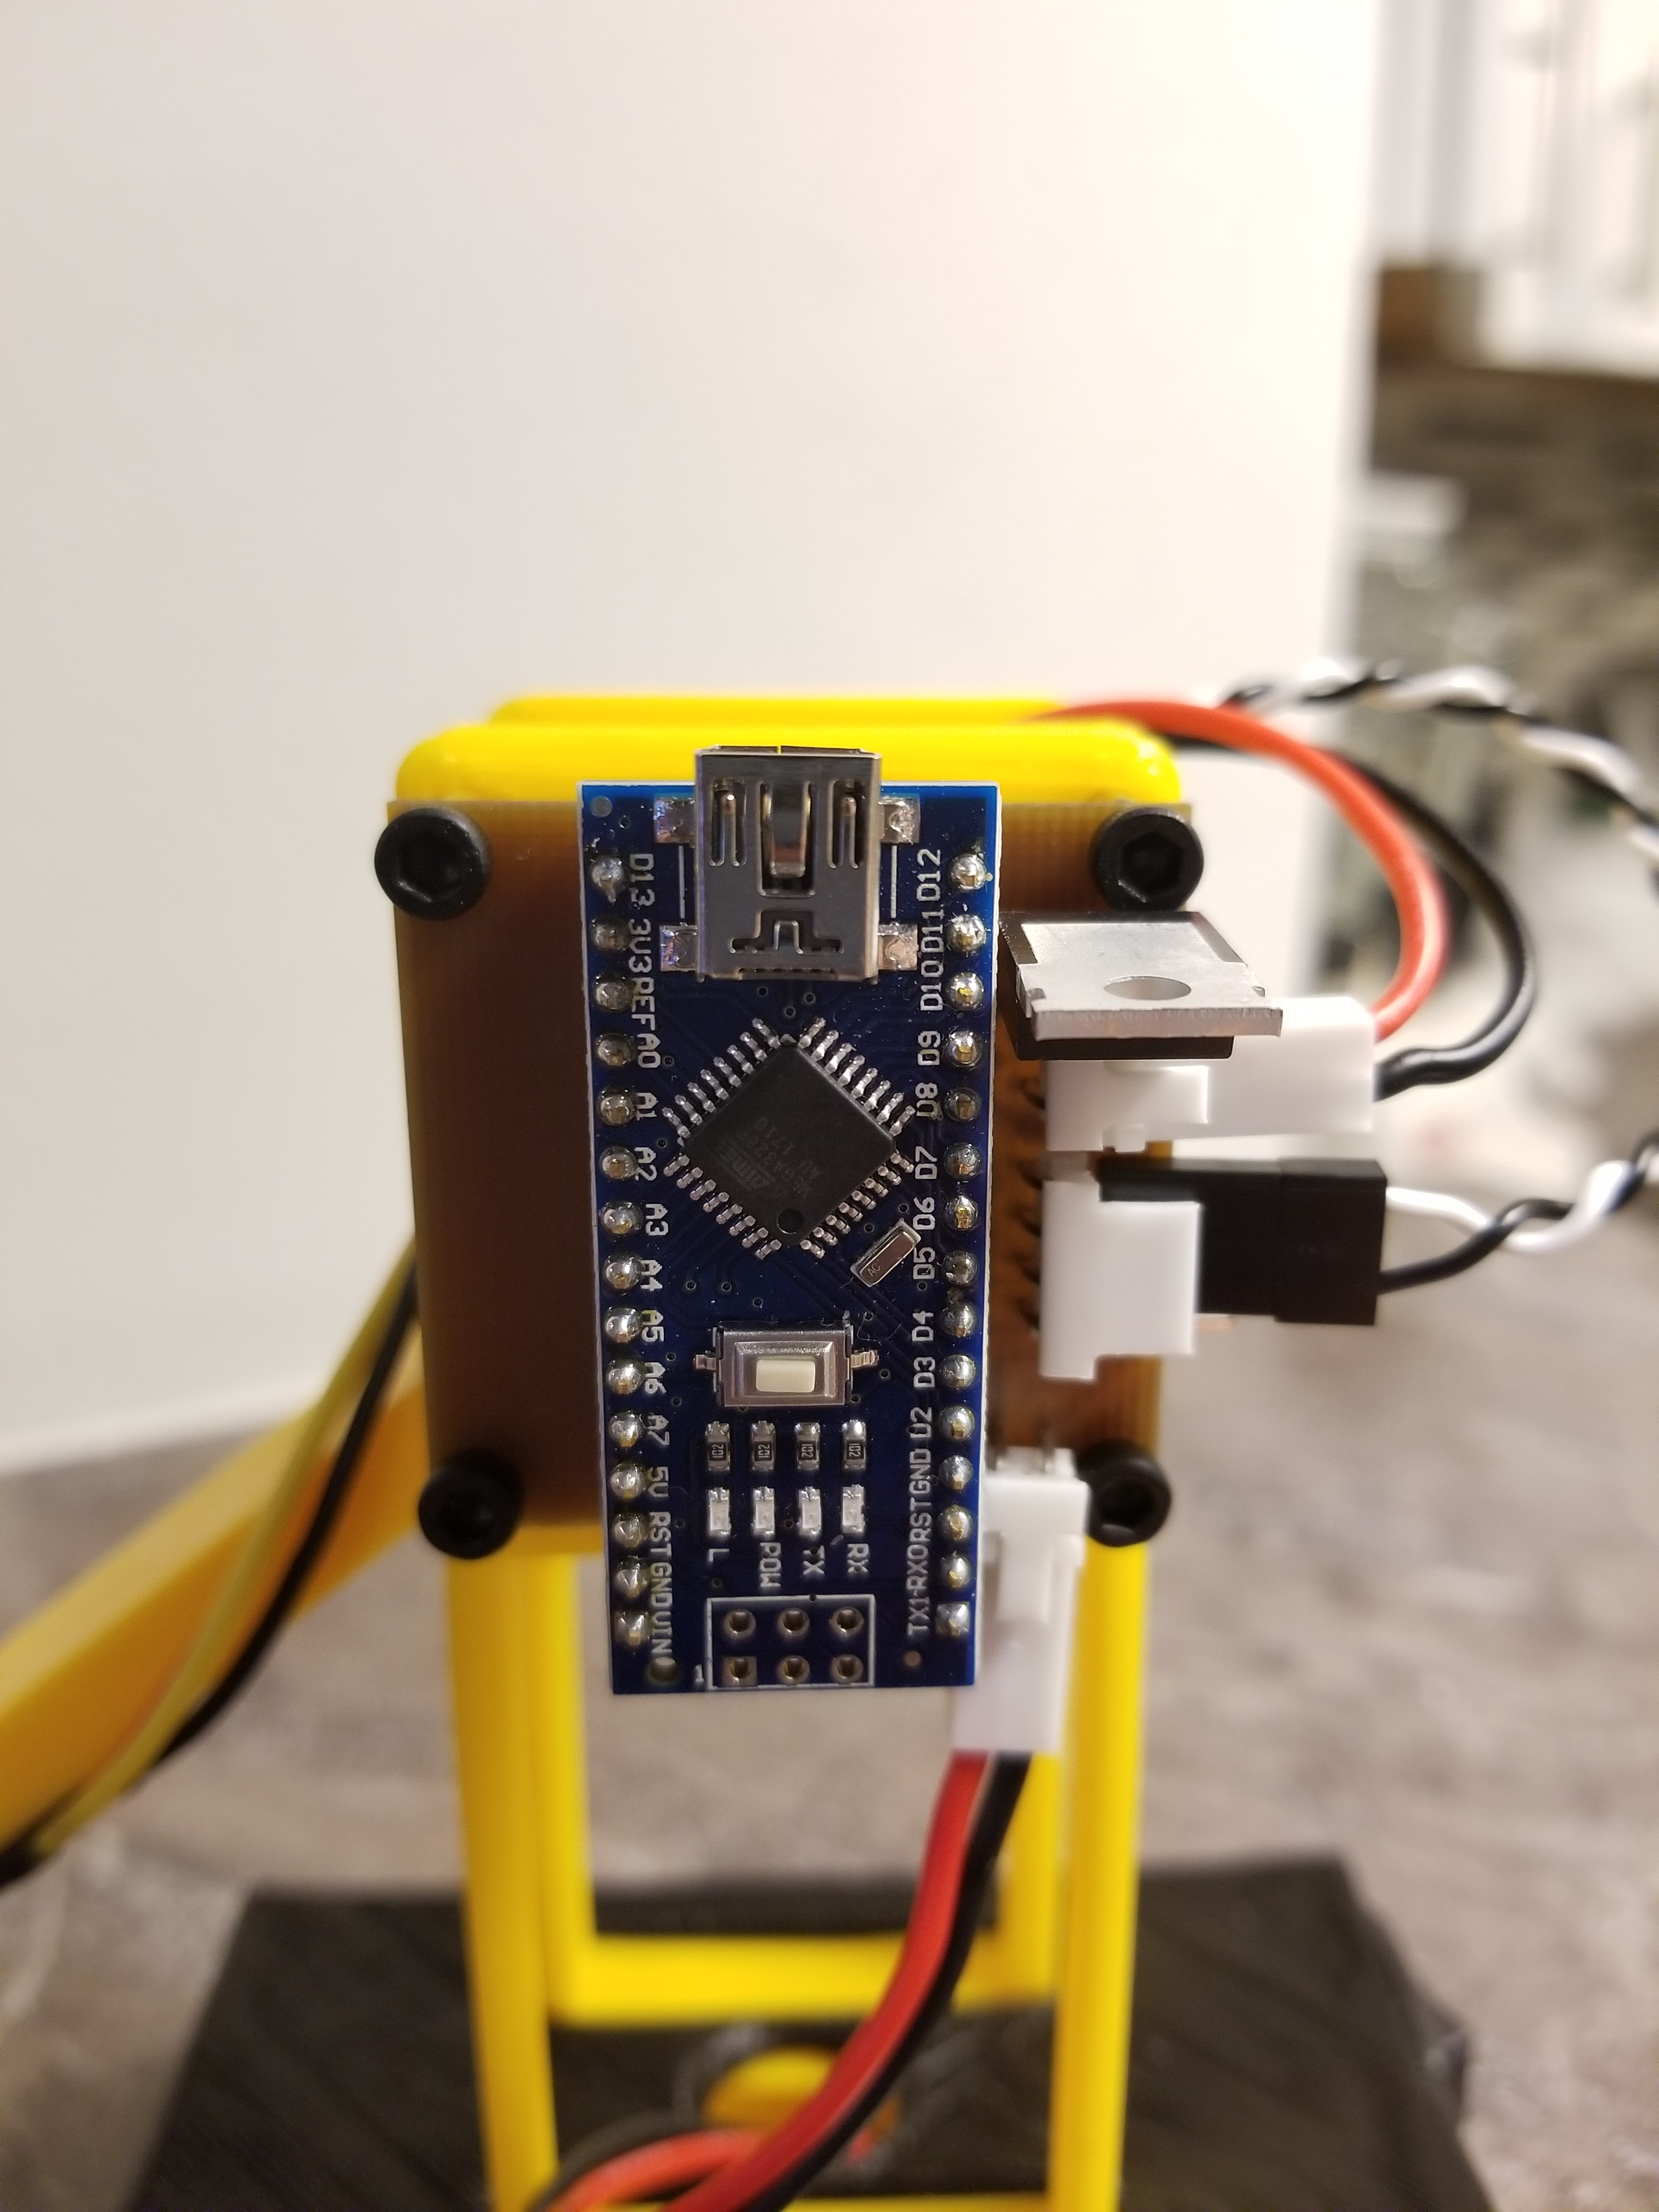
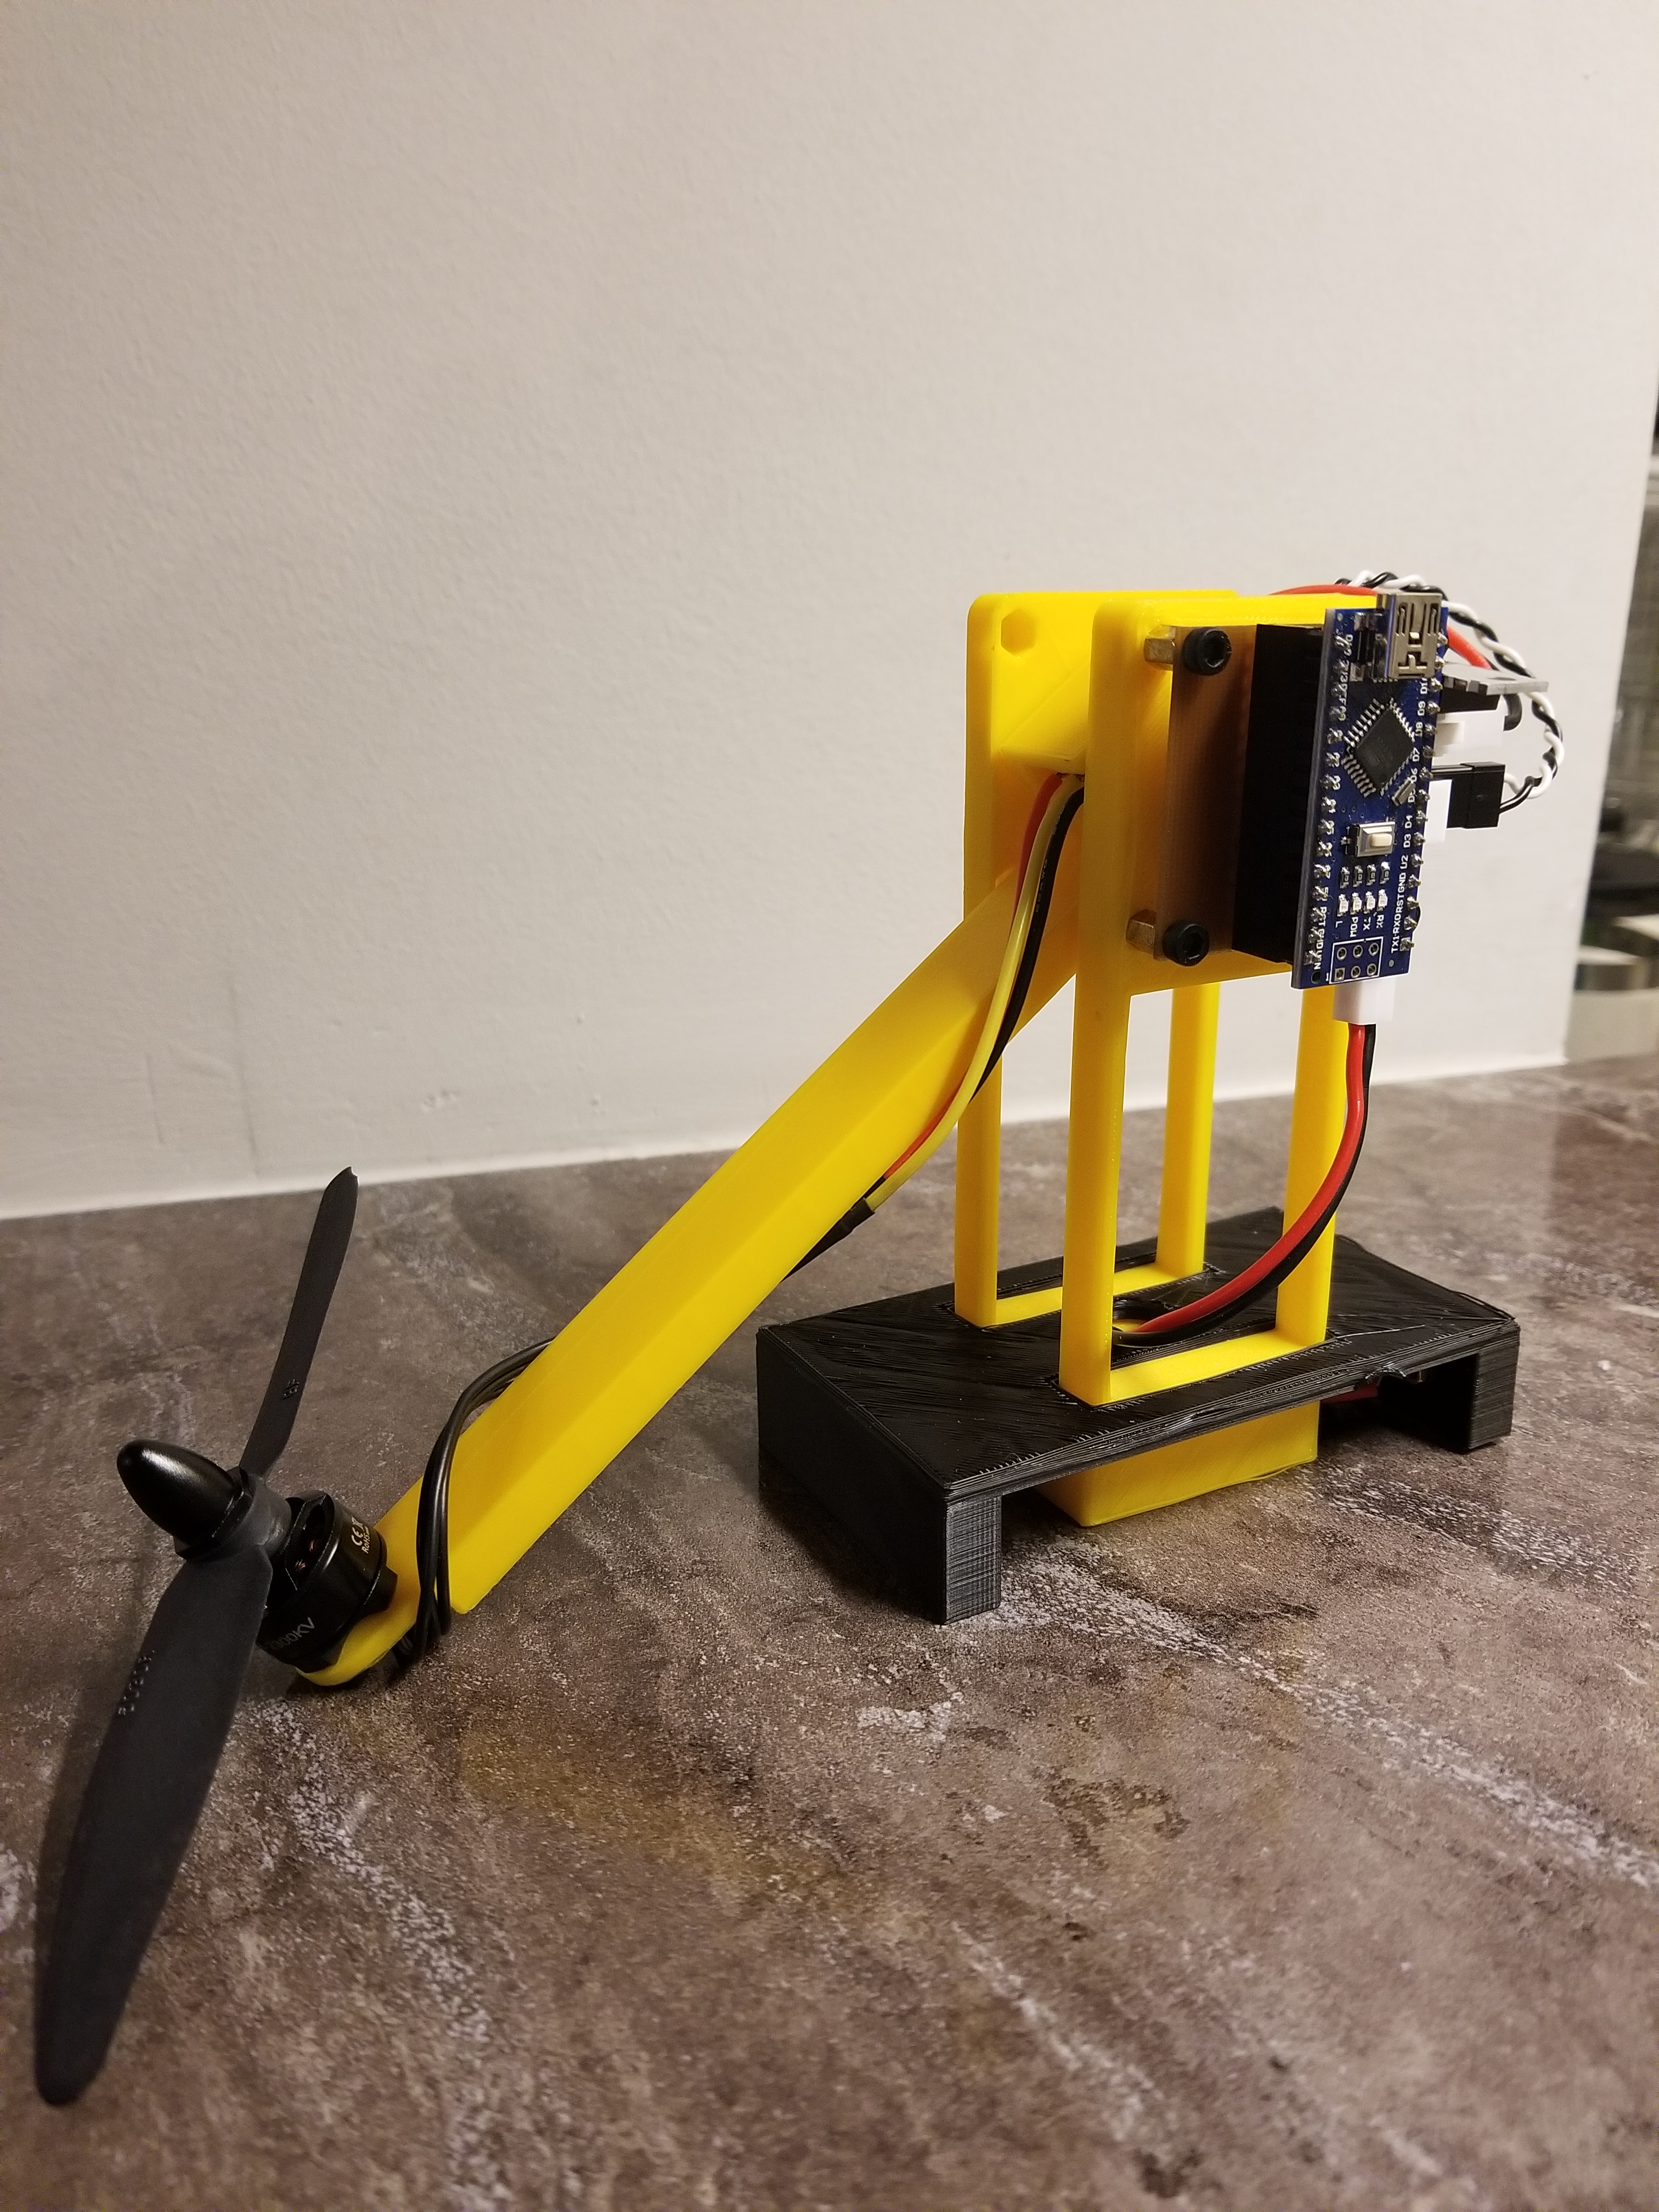
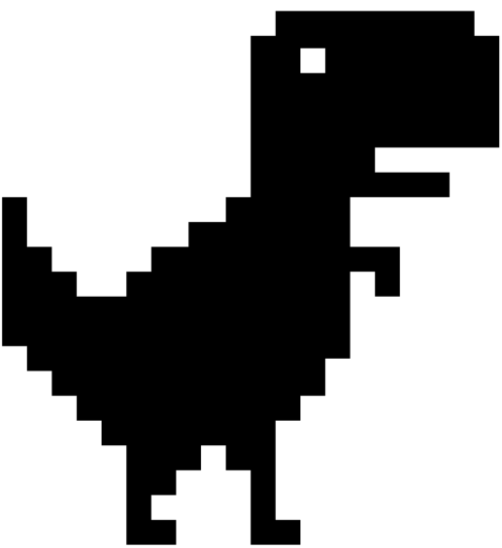
Introducing The T-RECS
Transportable
Rotorcraft
Electronic
Control
System

Slide 5
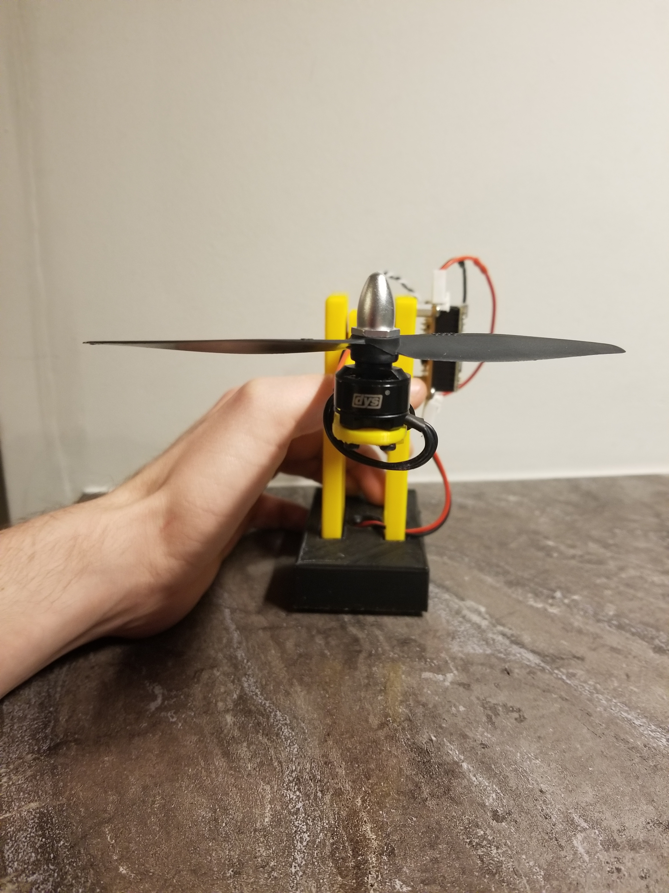
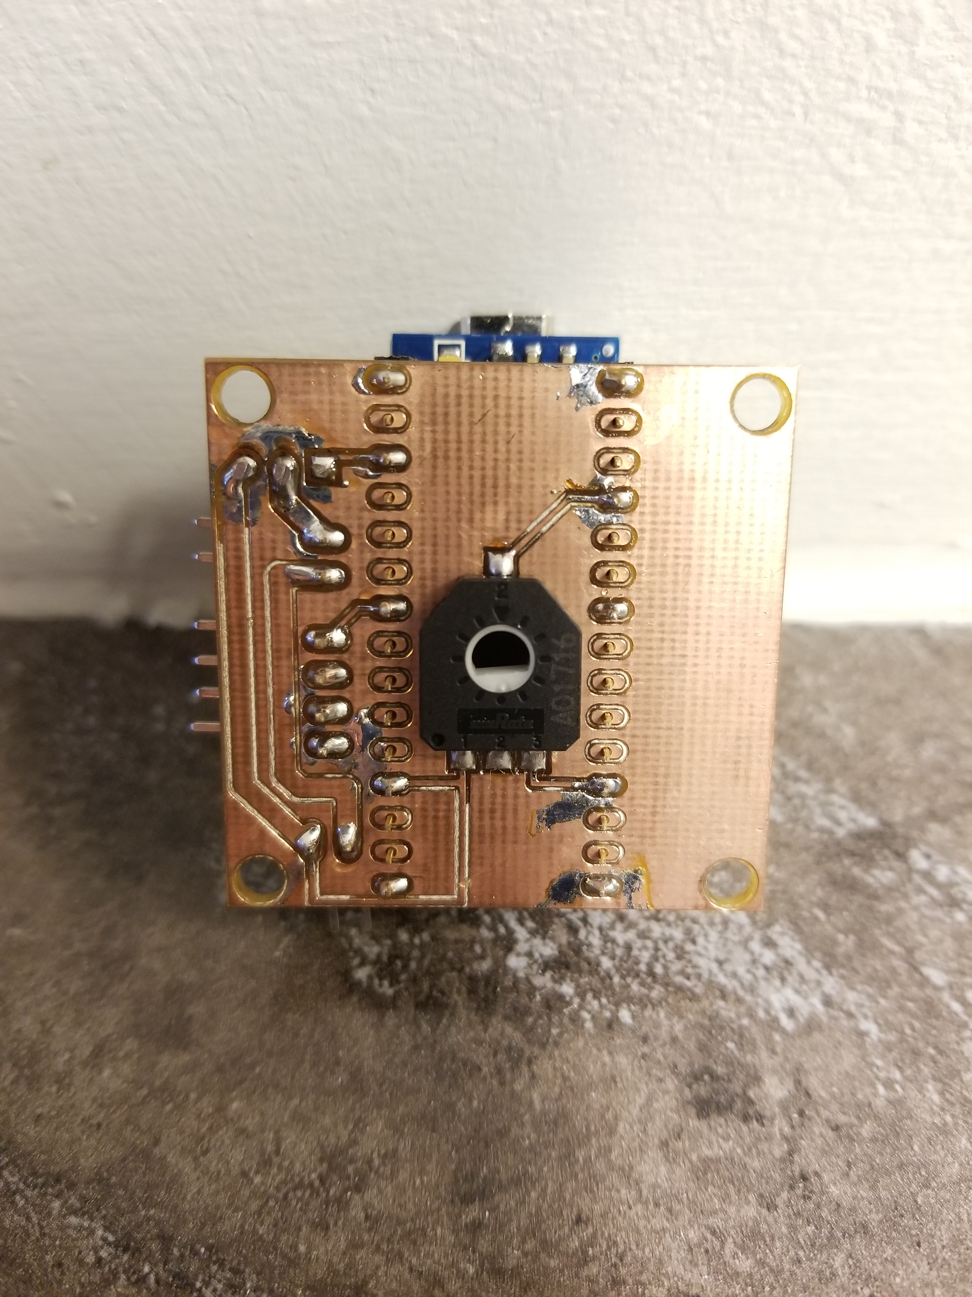
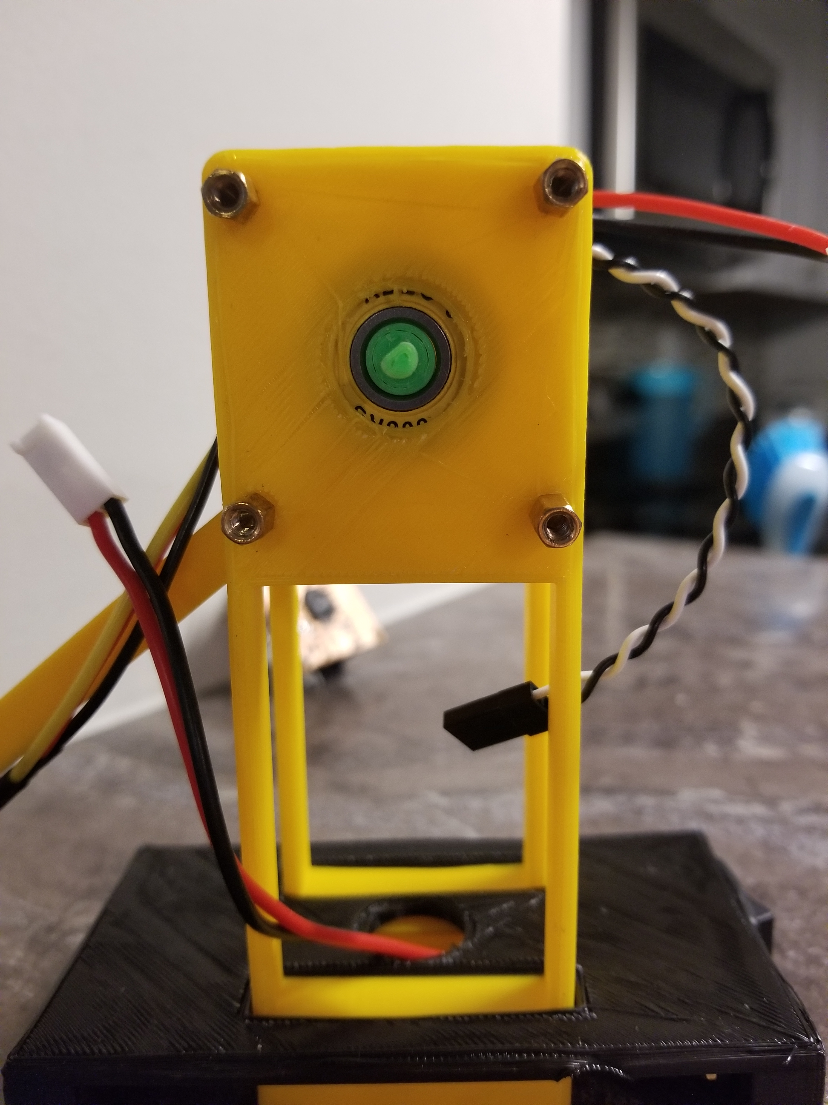
Mechanical Features
Brushless DC Motor
Common amongst RC Hobbyists
Arm on Low-Friction Bearing
Simple & Easy to Model
Rotary Position Sensor
Fixed to Arm Shaft

Slide 6
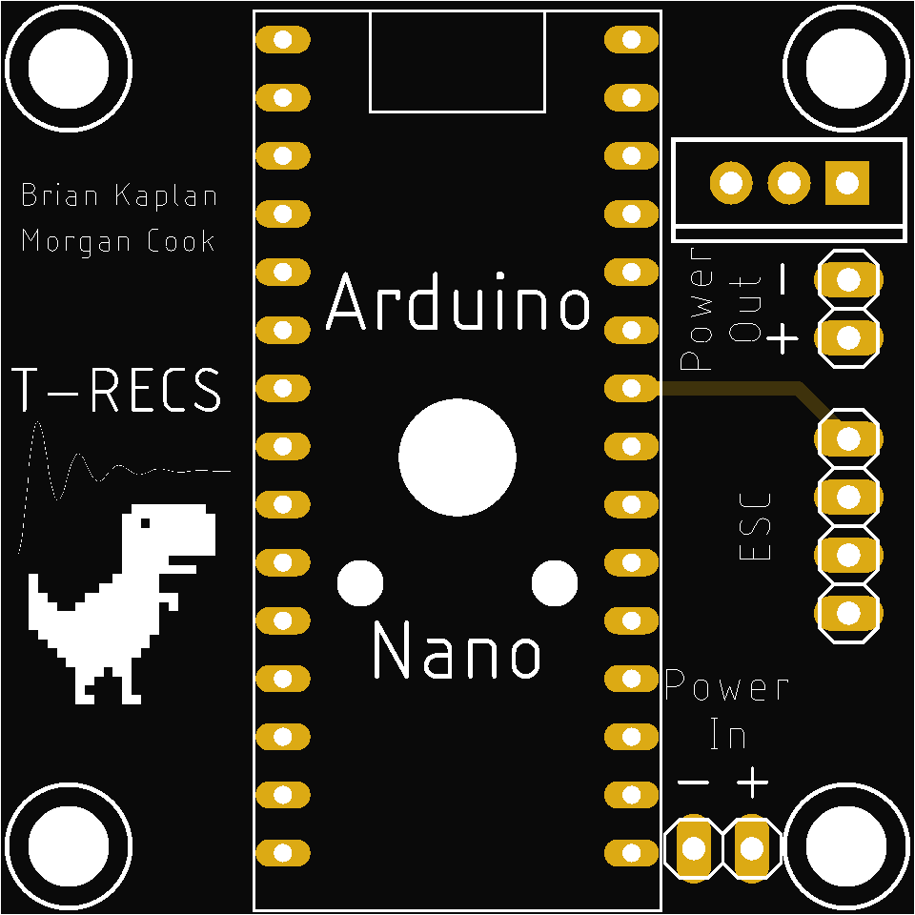
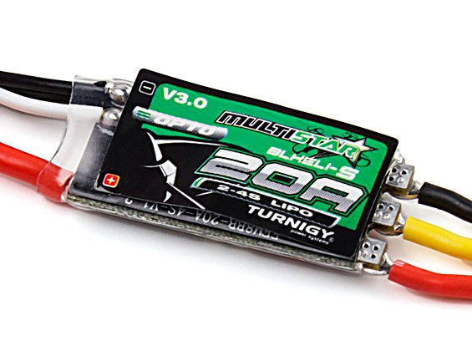
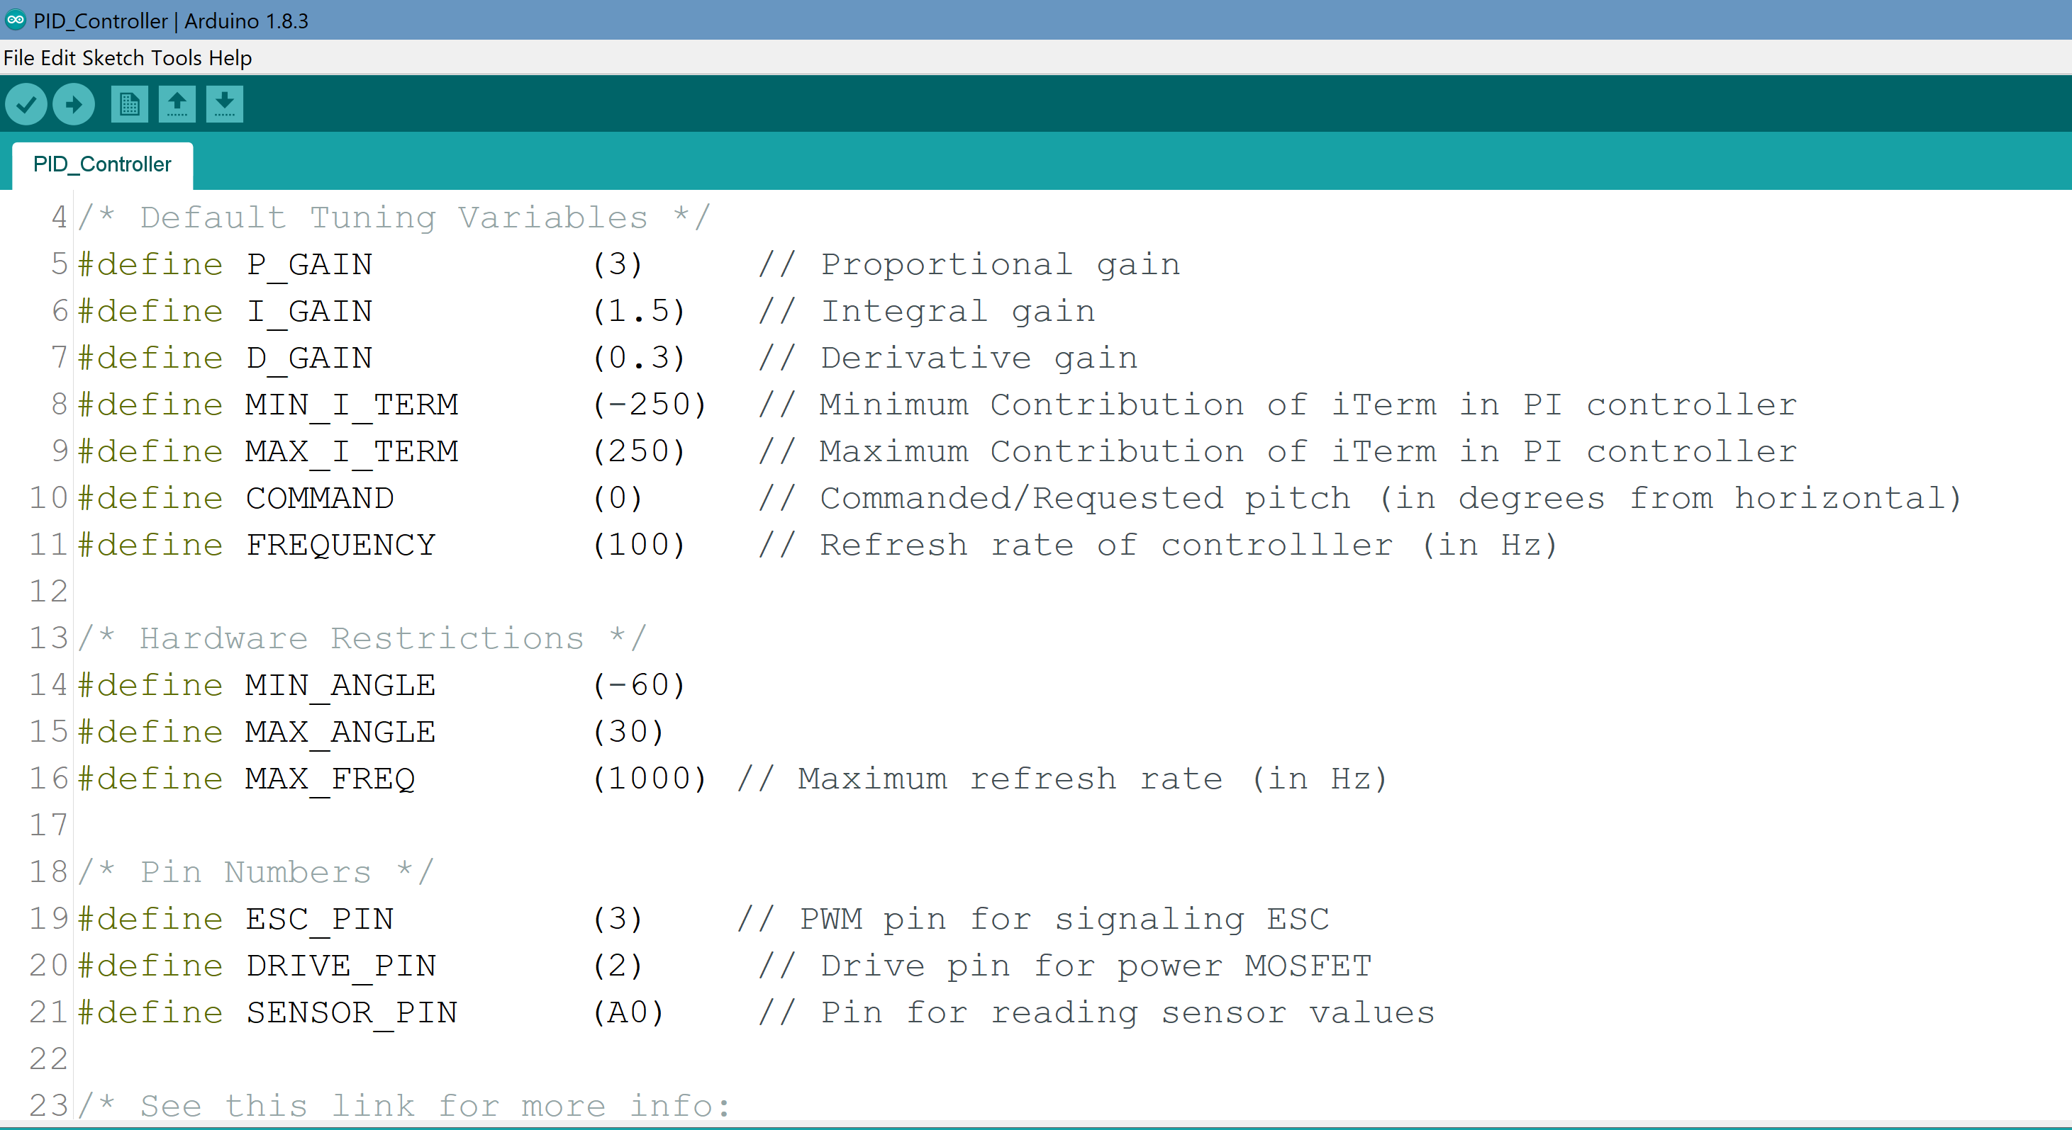
electrical Features
Electronic Speed Controller
Commonly Found in Quadcopters
Printed Circuit Board
Consolidated Electronics
Arduino Microcontroller & Software
Transparent & Easy to Follow

Slide 7
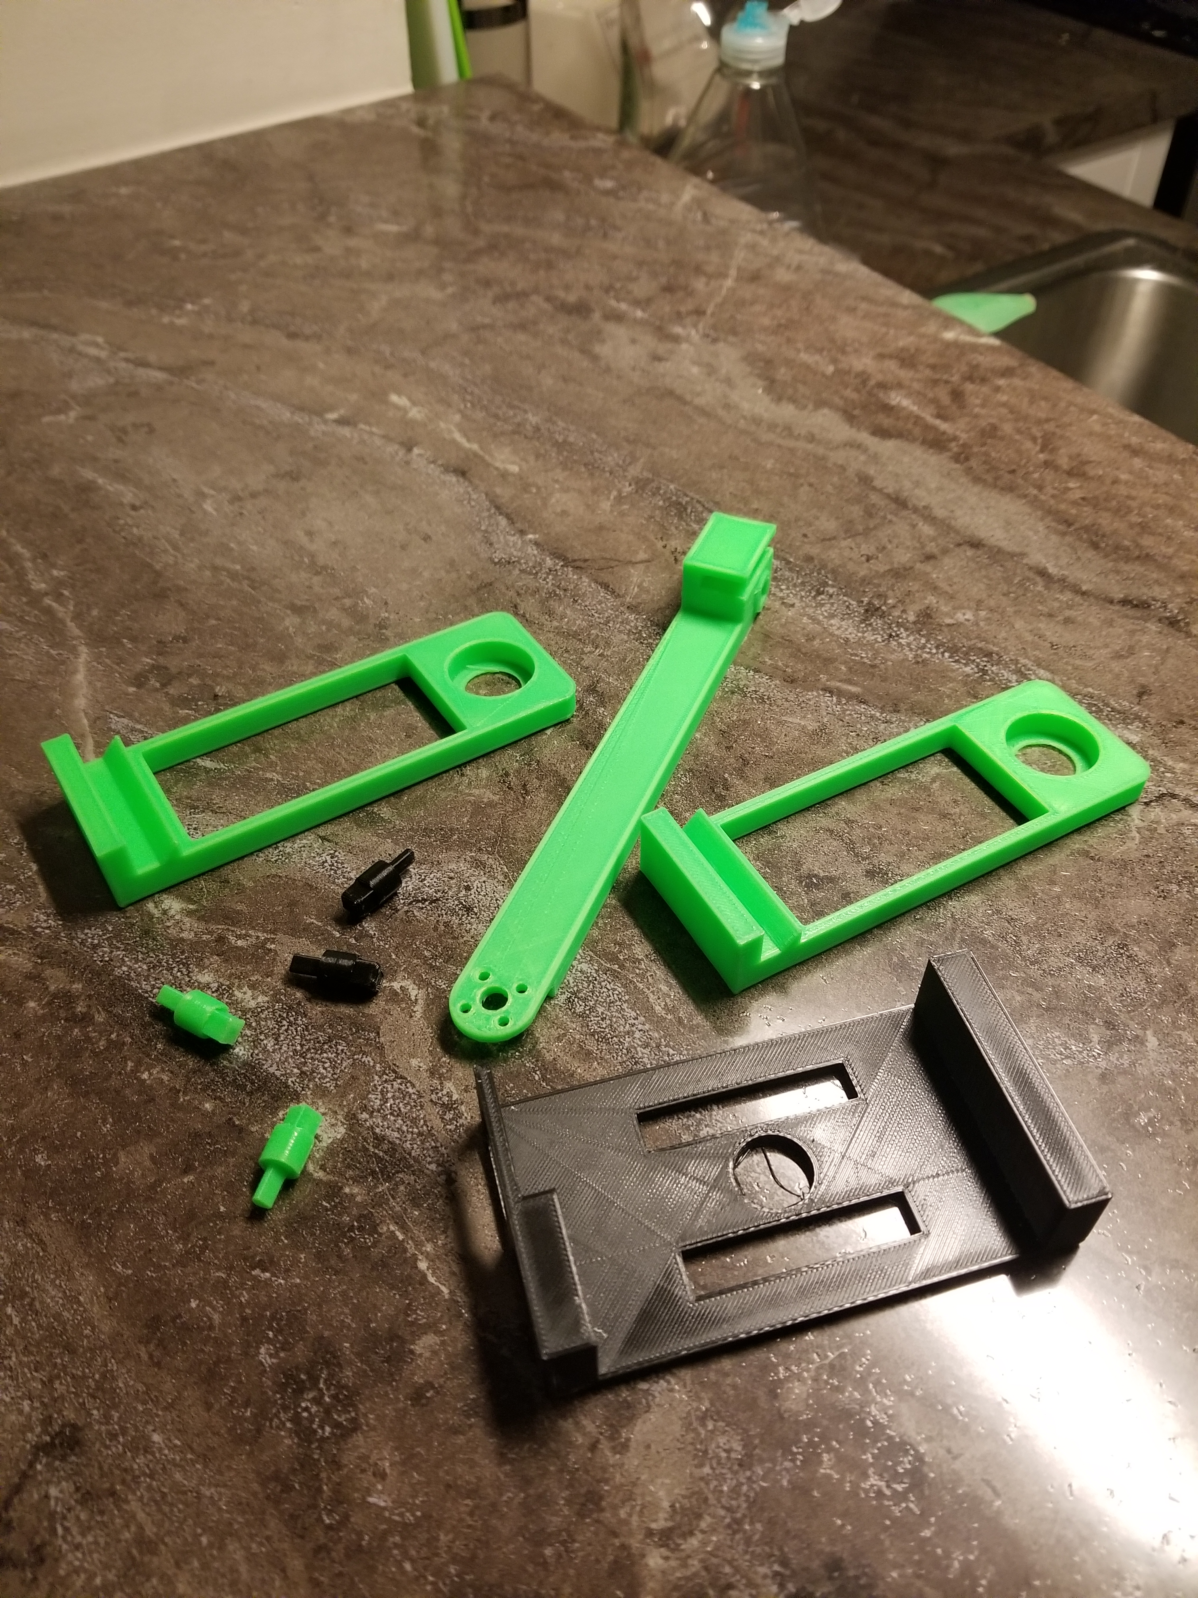
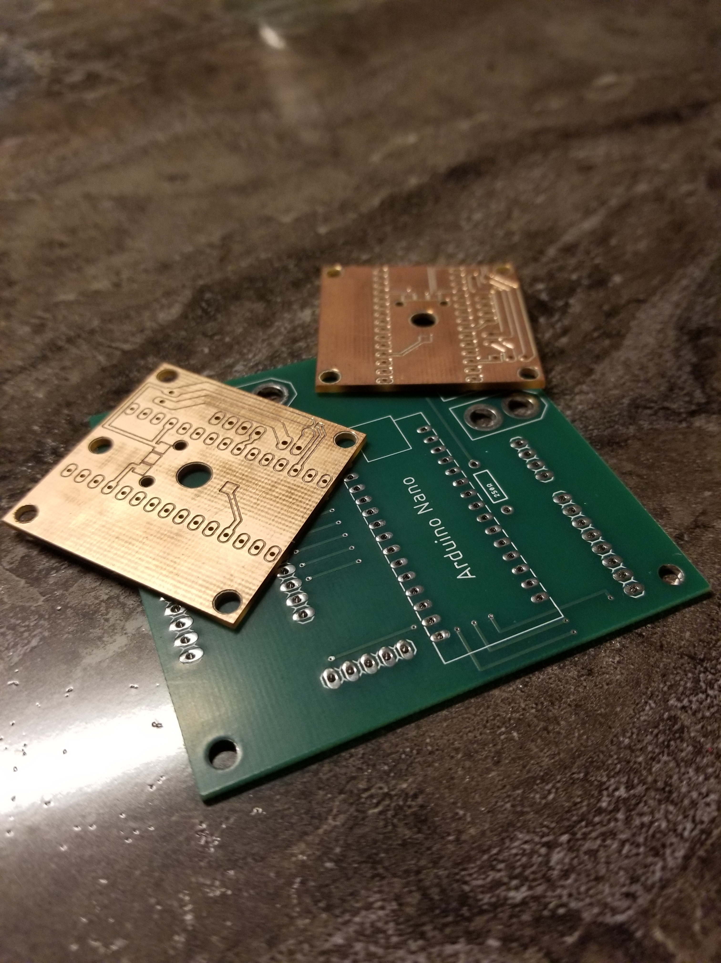
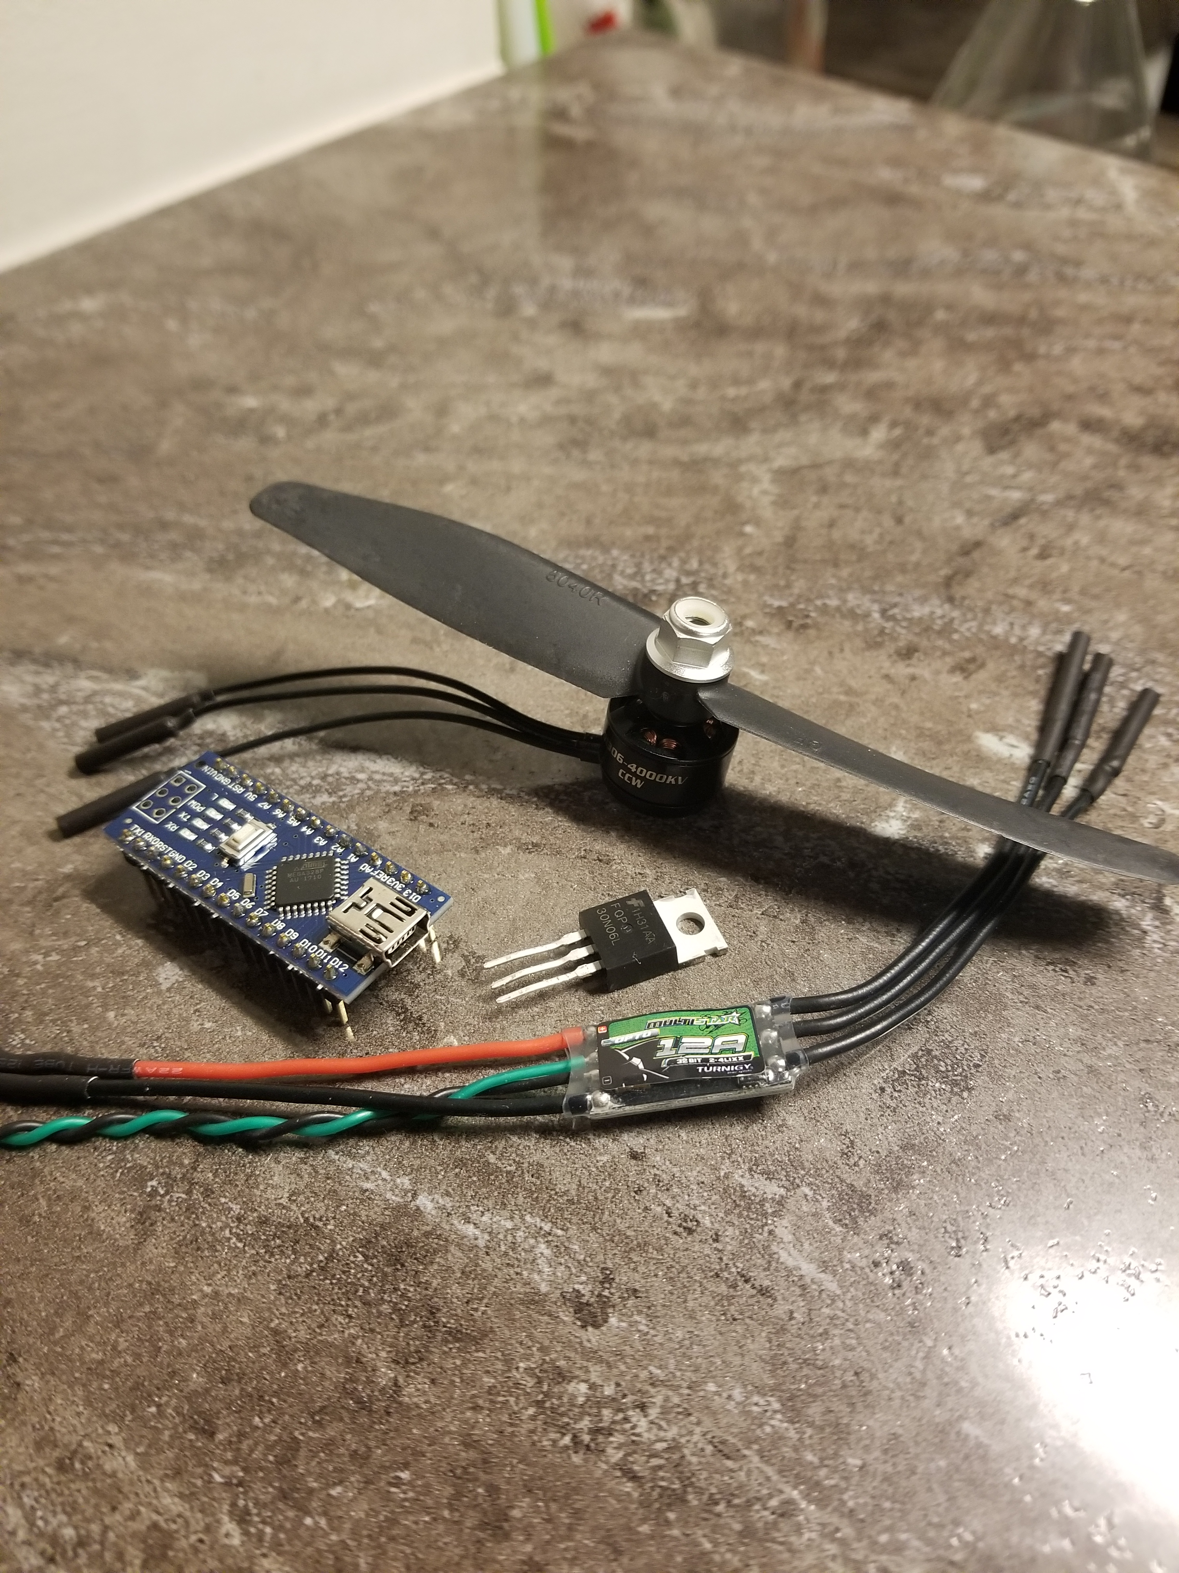
where do I get one?
You make it!
~$50 kit containing
Printed Circuit Board
Electronic Components
Mounting Hardware
Motor & ESC
STL Files
Arduino Code

Slide 8
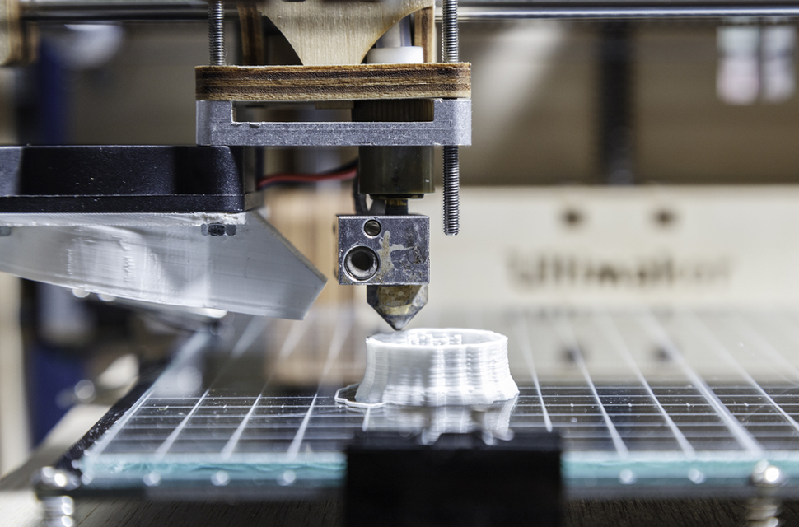
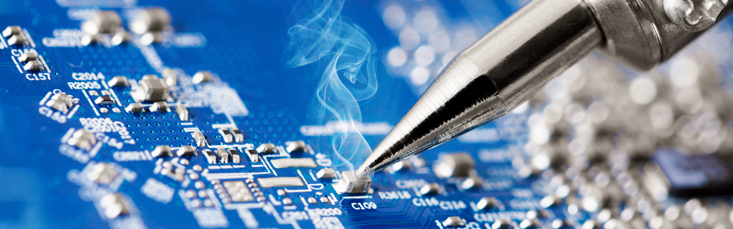

Manufacturing & Assembly
3D Printing
Soldering
Software
Stay Tuned for User Manual…

Slide 9
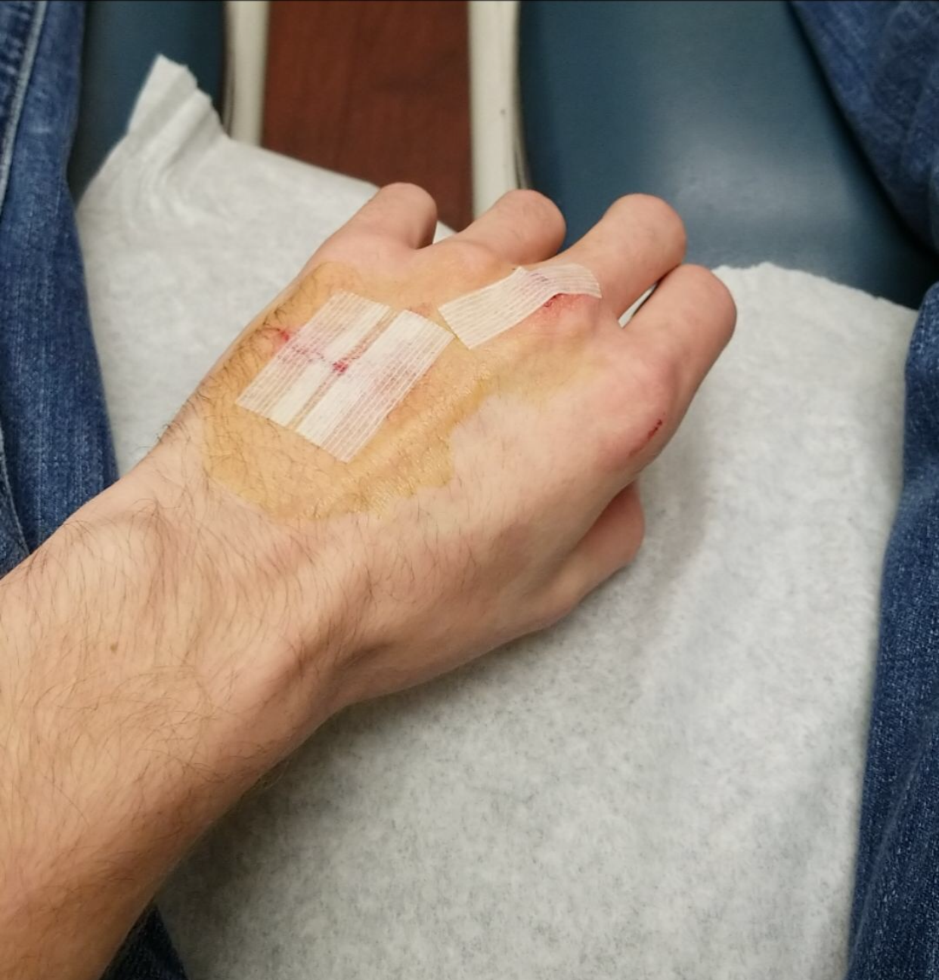
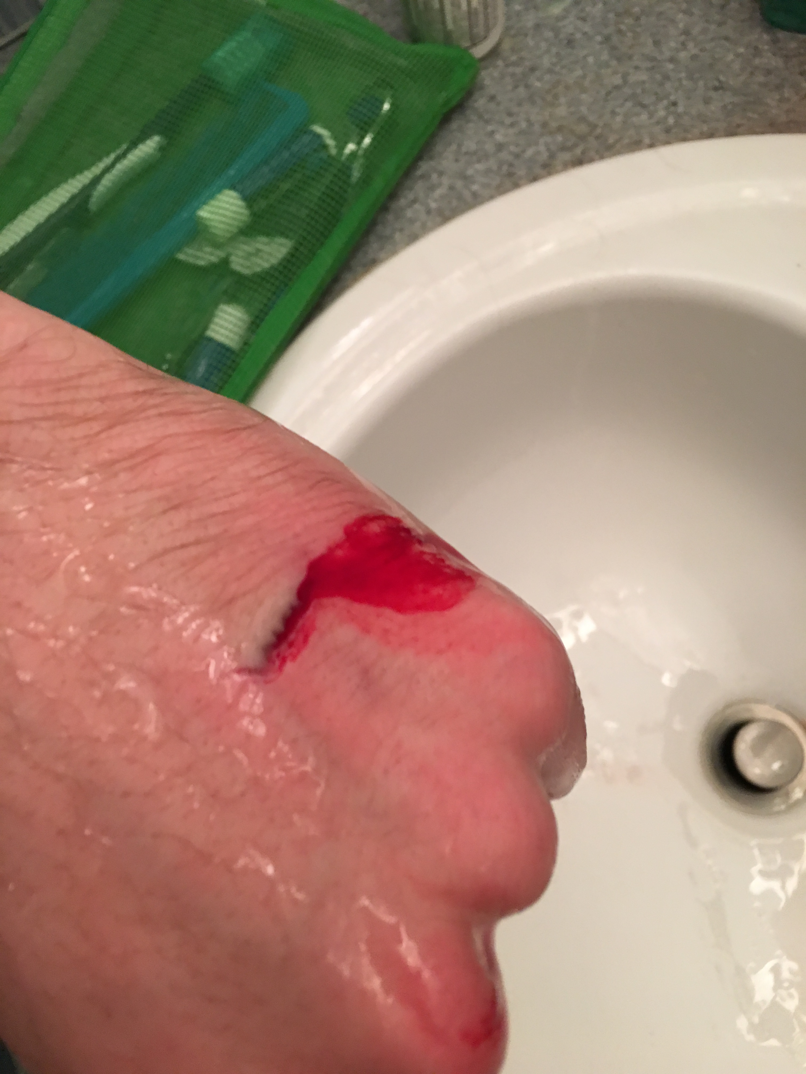
A note on Safety
These systems may be small, but the motors still operate at high speeds (~20,000 RPM)
This can easily cut your hands or fingers
May require a trip to the ER and some stitches
Secure your system to your workbench
Looking into cages
Be Careful!

Slide 10
Let’s See a demo!

Slide 11
Questions?

